Slide 1
Perancangan Sistem Pemrograman
UML Class Diagrams
Prepared by Frans Panduwinata, S.Kom, M.T

Slide 2
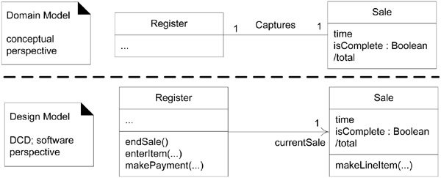
Design Class Diagram
In a conceptual perspective the class diagram can be used to visualize a domain model.

Slide 3
What is a class diagram?
Imagine you were given a task of drawing a family tree.
The steps you would take would be:
  Identify the main members of the family
  Determine how they are related to each other
  Identify the characteristics of each family member
  Find relations among family members
  Decide the inheritance of personal traits and characters
A class diagram is
a diagram showing a collection of classes and interfaces, along with the collaborations and relationships among classes and interfaces.

Slide 4
What is a class diagram? (cont)
How does a class diagram relate to the use case diagrams?
  The use cases talk about "what are the requirements" of a system.
  The aim of designing classes is to convert this “WHAT" to a “HOW" for each requirement.
  Each use case is further analyzed and broken up into atomic components that form the basis for the classes that need to be designed.

Slide 5
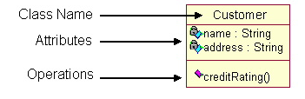
Structure of Class Diagram
Classes are composed of three things:
  a name,
  attributes, and
  operations.
EXAMPLE:

Slide 6

Association
When two classes are connected to each other in any way, an association relation is established.
EXAMPLE:
A "student studies in a college"

Slide 7

Multiplicity
An example of this kind of association is many students belonging to the same college.
Hence, the relation shows a star sign near the student class (one to many, many to many, and so forth kind of relations).
EXAMPLE:

Slide 8
Multiplicity (cont)
Potential Multiplicity Values
Indicator | Meaning
0..1 | Zero or one
1 | One only
0..* | Zero or more
* | Zero or more
1..* | One or more
3 | Three only
0..5 | Zero to Five
5..15 | Five to Fifteen

Slide 9
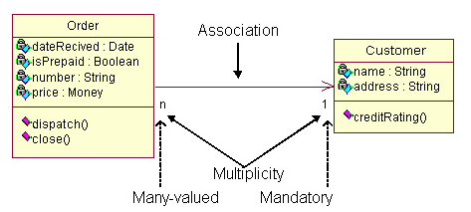
Examples
The class Order is associated with the class Customer.

Slide 10

Aggregation
When a class is formed as a collection of other classes, it is called an aggregation relationship between these classes.
It is also called a "has a" relationship.
EXAMPLE:

Slide 11

Composition
Composition is a variation of the aggregation relationship.
Composition connotes that a strong life cycle is associated between the classes.
EXAMPLE:

Slide 12
Aggregations VS Composites
Further example to differentiate aggregations and composites:
  Aggregations:
  For EXAMPLE,
  In a home entertainment system, a remote control might be a component of a television, and the same remote control might be a component of a VCR.
  Composites:
  For EXAMPLE,
  Each component in a composite can belong to just one whole.
  The components of a coffee table -- the tabletop and the legs.

Slide 13
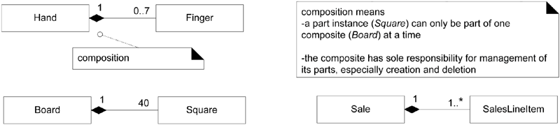
Aggregations VS Composites (cont)
EXAMPLE:

Slide 14
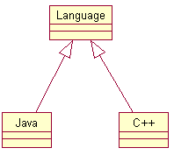
Inheritance/Generalization
Also called an "is a" relationship, because the child class is a type of the parent class.
The child classes "inherit" the common functionality defined in the parent class.
EXAMPLE:

Slide 15
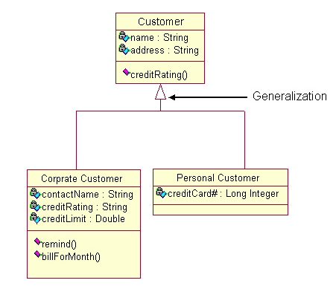
Inheritance/Generalization (cont)

Slide 16
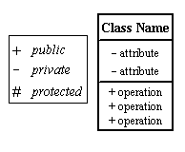
Visibility
Use visibility markers to signify who can access the information contained within a class.
  Private visibility hides information from anything outside the class partition.
  Public visibility allows all other classes to view the marked information.
  Protected visibility allows child classes to access information they inherited from a parent class.
Symbol:

Slide 17
Case Study
The potential actors of the Courseware Management System were:
  Tutors
  Course administrators
  Students
And the use cases of the system were:
  View courses
  Manage topics for a course
  Manage course information
  View course calendar

Slide 18
Case Study (cont)
List of classes and interfaces that we have identified in the Courseware Management System:
  CourseAdministrator
  Tutor
  Student
  Course
  Topic
  CourseCalendar

Slide 19
Case Study (cont)
Because our primary actor is the course administrator and the use cases were related to this actor, we can DIRECTLY MAP the use cases to the CourseAdministrator class as methods.
ClassName | Methods
CourseAdministrator | viewCourses() manageCourse() manageTopic() viewCourseCalendar() viewTutors() manageTutorInformation() assignTutorToCourse()

Slide 20
Case Study (cont)
ClassName | Methods
Course | viewAllCourses() viewCourseInformation() createCourse() modifyCourse() removeCourse()
Topic | viewAllTopics() viewTopicInformation() createTopic() modifyTopic() removeTopic()

Slide 21
Case Study (cont)
ClassName | Methods
Tutor | viewTutorInformation() createTutor() modifyTutor() removeTutor()
CourseCalendar | viewCourseCalendar()
Student | viewAllStudents() viewStudentInformation()

Slide 22
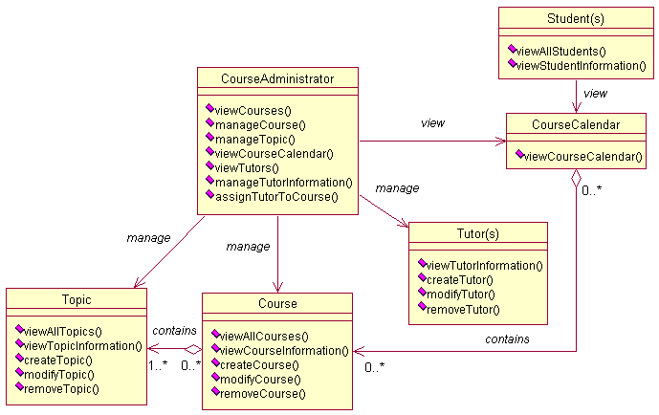
Case Study (cont)
Class diagram of Courseware Management System

Slide 23
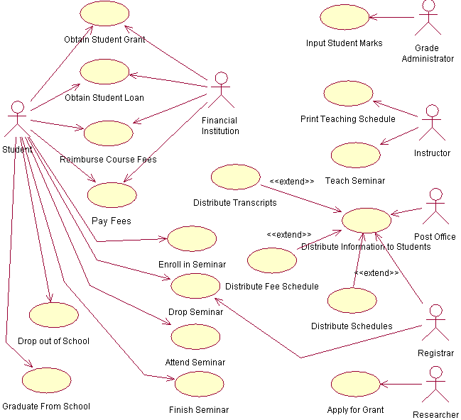
Exercise
TASK:
Create Class Diagram
from this use case

